Slide 1

UNIVERSITY INSTITUTE OF ENGINEERING
COMPUTER SCIENCE ENGINEERING
Master of Engineering
ADVANCED DATA STRUCTURES
&
ALGORITHMS
(23CSH-622)
INTRODUCTION
DISCOVER . LEARN . EMPOWER

Slide 2

ADVANCED DATA STRUCTURES
&
ALGORITHMS
(23CSH-622)
By : Dr. Ranjit Singh (E10947)
www. cuchd.in Campus : Gharaun, Mohali

Slide 3
AVL
Course Outcome
Will be covered in this lecture
CO Number | Title | Level
CO1 | To understand role of algorithms in science and practice of computing.. | Remember
CO2 | To gain familiarization with different algorithm design techniques. | Understand
CO3 | To apply different algorithm design techniques for solving engineering and related problems and study their performance. | Analysis and application

Slide 4
Lecture Objectives
To impart the concepts of need of AVL tree
To understand the algorithm to insert in AVL tree.
To calculate the Balance Factor of AVL tree.
To Understand the algorithm for deletion in AVL.
Lecture Outcome:-Students will
Understand the concepts of AVL tree and need for it.
Understand the insertion and deletion algorithms of AVL.
Understand how to calculate the balancing factor.

Slide 5
Contents to be covered
Drawback of BST/Motivation for AVL tree
Height of an AVL tree
AVL Tree Insert and Remove
Balance Condition Violation
AVL Trees Rotation

Slide 6
Motivation
When building a binary search tree, what type of trees would we like? Example: 3, 5, 8, 20, 18, 13, 22
3
5
13
8
5
20
13
18
3
8
18
22
20
22

Slide 7
Motivation
Complete binary tree is hard to build when we allow dynamic insert and remove.
We want a tree that has the following properties
Tree height = O(log(N))
allows dynamic insert and remove with O(log(N)) time complexity.
The AVL tree is one of this kind of trees.
8
13
5
18
5
20
3
13
20
3
8
18
22
22

Slide 8
AVL (Adelson-Velskii and Landis) Trees
AVL Tree can be defined as height balanced binary search tree in which each node is associated with a balance factor which is calculated by subtracting the height of its right sub-tree from that of its left sub-tree.
Tree is said to be balanced if balance factor of each node is in between -1 to 1, otherwise, the tree will be unbalanced and need to be balanced.
Balance Factor (k) = height (left(k)) - height (right(k))

Slide 9
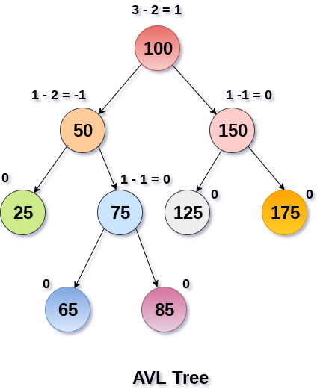
AVL Tree

Slide 10
AVL (Adelson-Velskii and Landis) Trees
AVL tree is a binary search tree with balance condition
To ensure depth of the tree is O(log(N))
And consequently, search/insert/remove complexity bound O(log(N))
Balance condition
For every node in the tree, height of left and right subtree can differ by at most 1

Slide 11
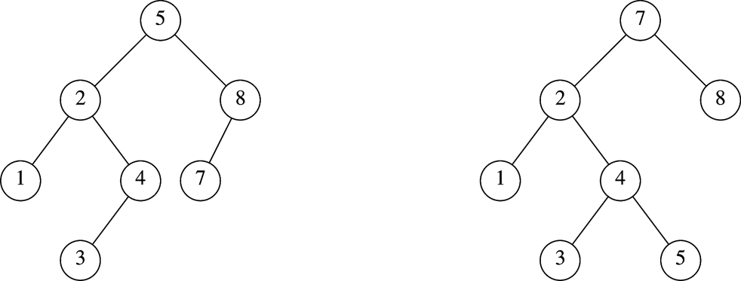
Which is an AVL Tree?

Slide 12
AVL Tree Insert and Remove
Do binary search tree insert and remove
The balance condition can be violated sometimes
Do something to fix it : rotations
After rotations, the balance of the whole tree is maintained

Slide 13
Balance Condition Violation
If condition violated after a node insertion
Which nodes do we need to rotate?
Only nodes on path from insertion point to root may have their balance altered
Rebalance the tree through rotation at the deepest node with balance violated
The entire tree will be rebalanced
Violation cases at node k (deepest node)
An insertion into left subtree of left child of k
An insertion into right subtree of left child of k
An insertion into left subtree of right child of k
An insertion into right subtree of right child of k
Cases 1 and 4 equivalent
Single rotation to rebalance
Cases 2 and 3 equivalent
Double rotation to rebalance

Slide 14
AVL Trees Complexity
Overhead
Extra space for maintaining height information at each node
Insertion and deletion become more complicated, but still O(log N)
Advantage
Worst case O(log(N)) for insert, delete, and search

Slide 15
Rotation in AVL Trees
Whenever we insert nodes in a tree or create a tree we need to verify its balance factor after every single operation. Balance factor of tree should be maintained.
If balance factor is disturbed then we need to rebalance it.
AVL rotations are of four types :
Left rotation
Right rotation
Left-Right rotation
Right-Left rotation

Slide 16
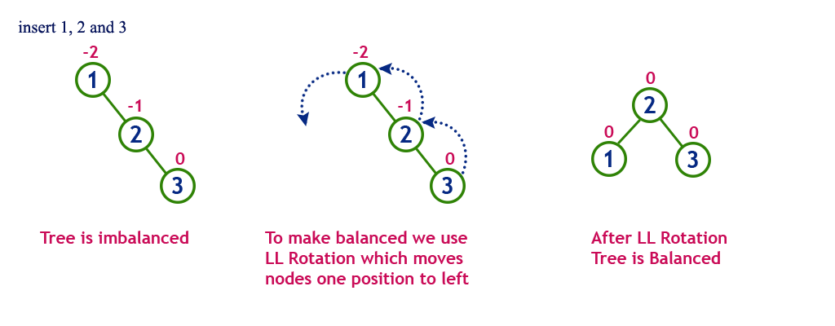
Single Left Rotation LL Rotation
In LL Rotation, every node moves one position to left from the current position.
16
Notes:
16

Slide 17
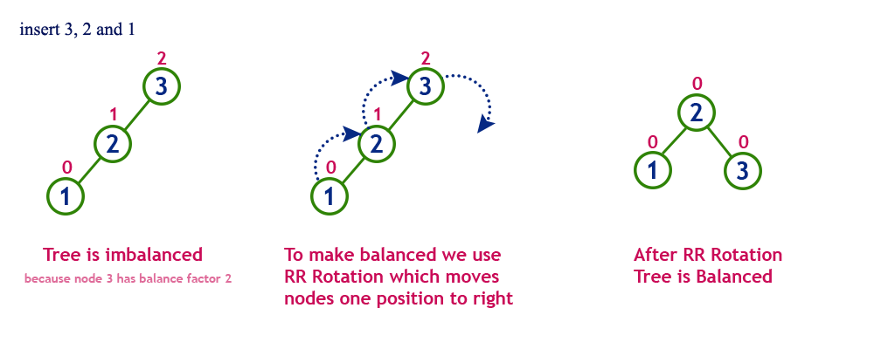
Single Right Rotation RR ROTATION
In RR Rotation, every node moves one position to right from the current position.

Slide 18
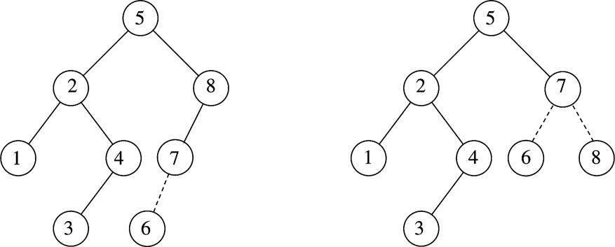
Example
After inserting 6
Balance condition at node 8 is violated

Slide 19
Example
Inserting 3, 2, 1, and then 4 to 7 sequentially into empty AVL tree
3
2
2
1
3
1

Slide 20
Example (Cont’d)
2
Inserting 4
Inserting 5
1
3
4
2
2
1
3
4
1
4
5
3
5

Slide 21
Example (Cont’d)
4
2
Inserting 6
Inserting 7
2
5
1
4
1
3
6
3
5
6
4
4
2
6
2
5
1
3
5
7
1
3
6
7

Slide 22
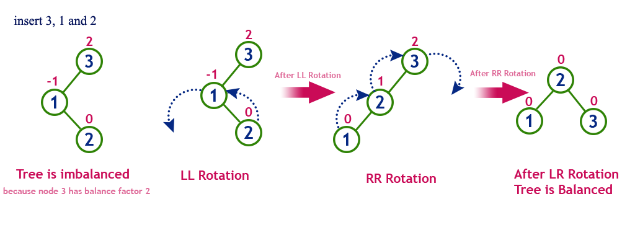
Left Right Rotation LR Rotation
The LR Rotation is a sequence of single left rotation followed by a single right rotation. In LR Rotation, at first, every node moves one position to the left and one position to right from the current position
The LR Rotation is a sequence of single left rotation followed by a single right rotation. In LR Rotation, at first, every node moves one position to the left and one position to right from the current position.

Slide 23
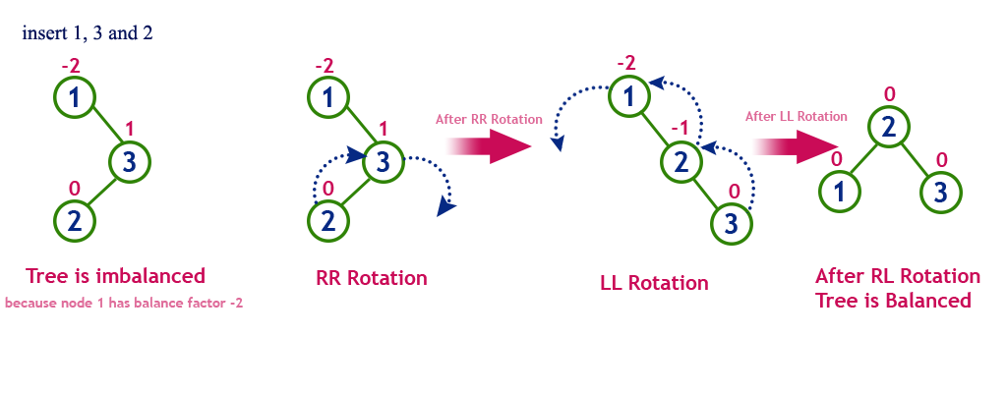
Right Left Rotation RL Rotation
The RL Rotation is sequence of single right rotation followed by single left rotation. In RL Rotation, at first every node moves one position to right and one position to left from the current position.

Slide 24
Example
Continuing the previous example by inserting values:
Inserting 16 and 15
4
4
2
6
2
6
1
3
5
15
1
3
5
7
7
16
16
15
24
Notes:
24

Slide 25
Example (Cont’d)
Inserting 14
4
4
2
7
2
6
1
3
6
15
1
3
5
15
14
16
7
16
5
14
25
Notes:
25

Slide 26
Construct an AVL tree by inserting the following elements in the given order.
63, 9, 19, 27, 18, 108, 99, 81
Also check for number of rotation applied.

Slide 27
Deletion in AVL Tree
Consider procedure of BST:
Delete leaf node.
Delete Node with one child. (make child node parent after deletion
Delete node with two children. (Replace deleted node with either inorder predecessor or inorder successor)
Inorder predecessor= largest element on left side of deleted node
Inorder successor = smallest element on left side of deleted node

Slide 28
Complexity
Complexity in AVL Tree:
The best case scenario is when the element to be found is the root element itself. Hence, the element is found in the first pass and traversing the whole tree is not necessary. This makes the time complexity as O(1).
The worst case is when the element to be found is present in one of the leaf nodes of the tree and we have to traverse throughout the length of the tree to find it. Hence the time complexity will be O(log n).
The average case time complexity for searching is also O(log n).

Slide 29
Practice Question:
What order should we insert the elements {1, 2. . . , 7} into an empty AVL tree so that we don’t have to perform any rotations on it ?
The number of rotations required to insert a sequence of elements 9,6,5,8,7,10 into an empty AVL tree is?

Slide 30
{4, 2, 6, 1, 3, 5, 7}
3 rotations

Slide 31
References
Li`pschutz, Seymour, “Data Structures”, Schaum's Outline Series, Tata McGraw Hill.
Data structure and algorithm by Narasimha Karumanchi.
www.tutorialspoint.com
www.geeksforgeeks.com
31

Slide 32
Books Recommended
Goodrich, Michael T., Tamassia, Roberto, and Mount, David M., “Data Structures and Algorithms in C++”, Wiley Student Edition.
Aho, Alfred V., Ullman, Jeffrey D., Hopcroft ,John E. “Data Structures and Algorithms”, Addison Wesley
Lipschutz, Seymour, “Data Structures”, Schaum's Outline Series, Tata McGraw Hill.
Gilberg/Forouzan,” Data Structure with C ,Cengage Learning.
Augenstein,Moshe J , Tanenbaum, Aaron M, “Data Structures using C and C++”, Prentice Hall of India

